Slide 1

Molecular Modeling Program: Pymol (1)
Evan Edelstein
Notes:
https://pdb101.rcsb.org/learn/other-resources/molecular-backgrounds-for-virtual-meetings

Slide 2
Downloading and Running Pymol:
Educational license: https://pymol.org/edu/?q=educational/
Open-Source version: https://github.com/schrodinger/pymol-open-source/blob/master/INSTALL
Academic Use: Open ticket with Einstein IT: https://itsupport.einsteinmed.org/
To access Pymol:
Open a terminal or command prompt and type: Pymol
Notes:
Warren L. DeLano

Slide 3
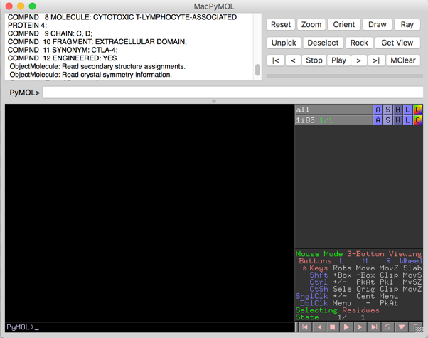
Pymol Interface: (MUCH EASIER WITH A MOUSE)
Command Line
Object Menu
Panel
Display Area
Mouse controls
Command Line
Movie controls
View mode
rotate
zoom
translate

Slide 4
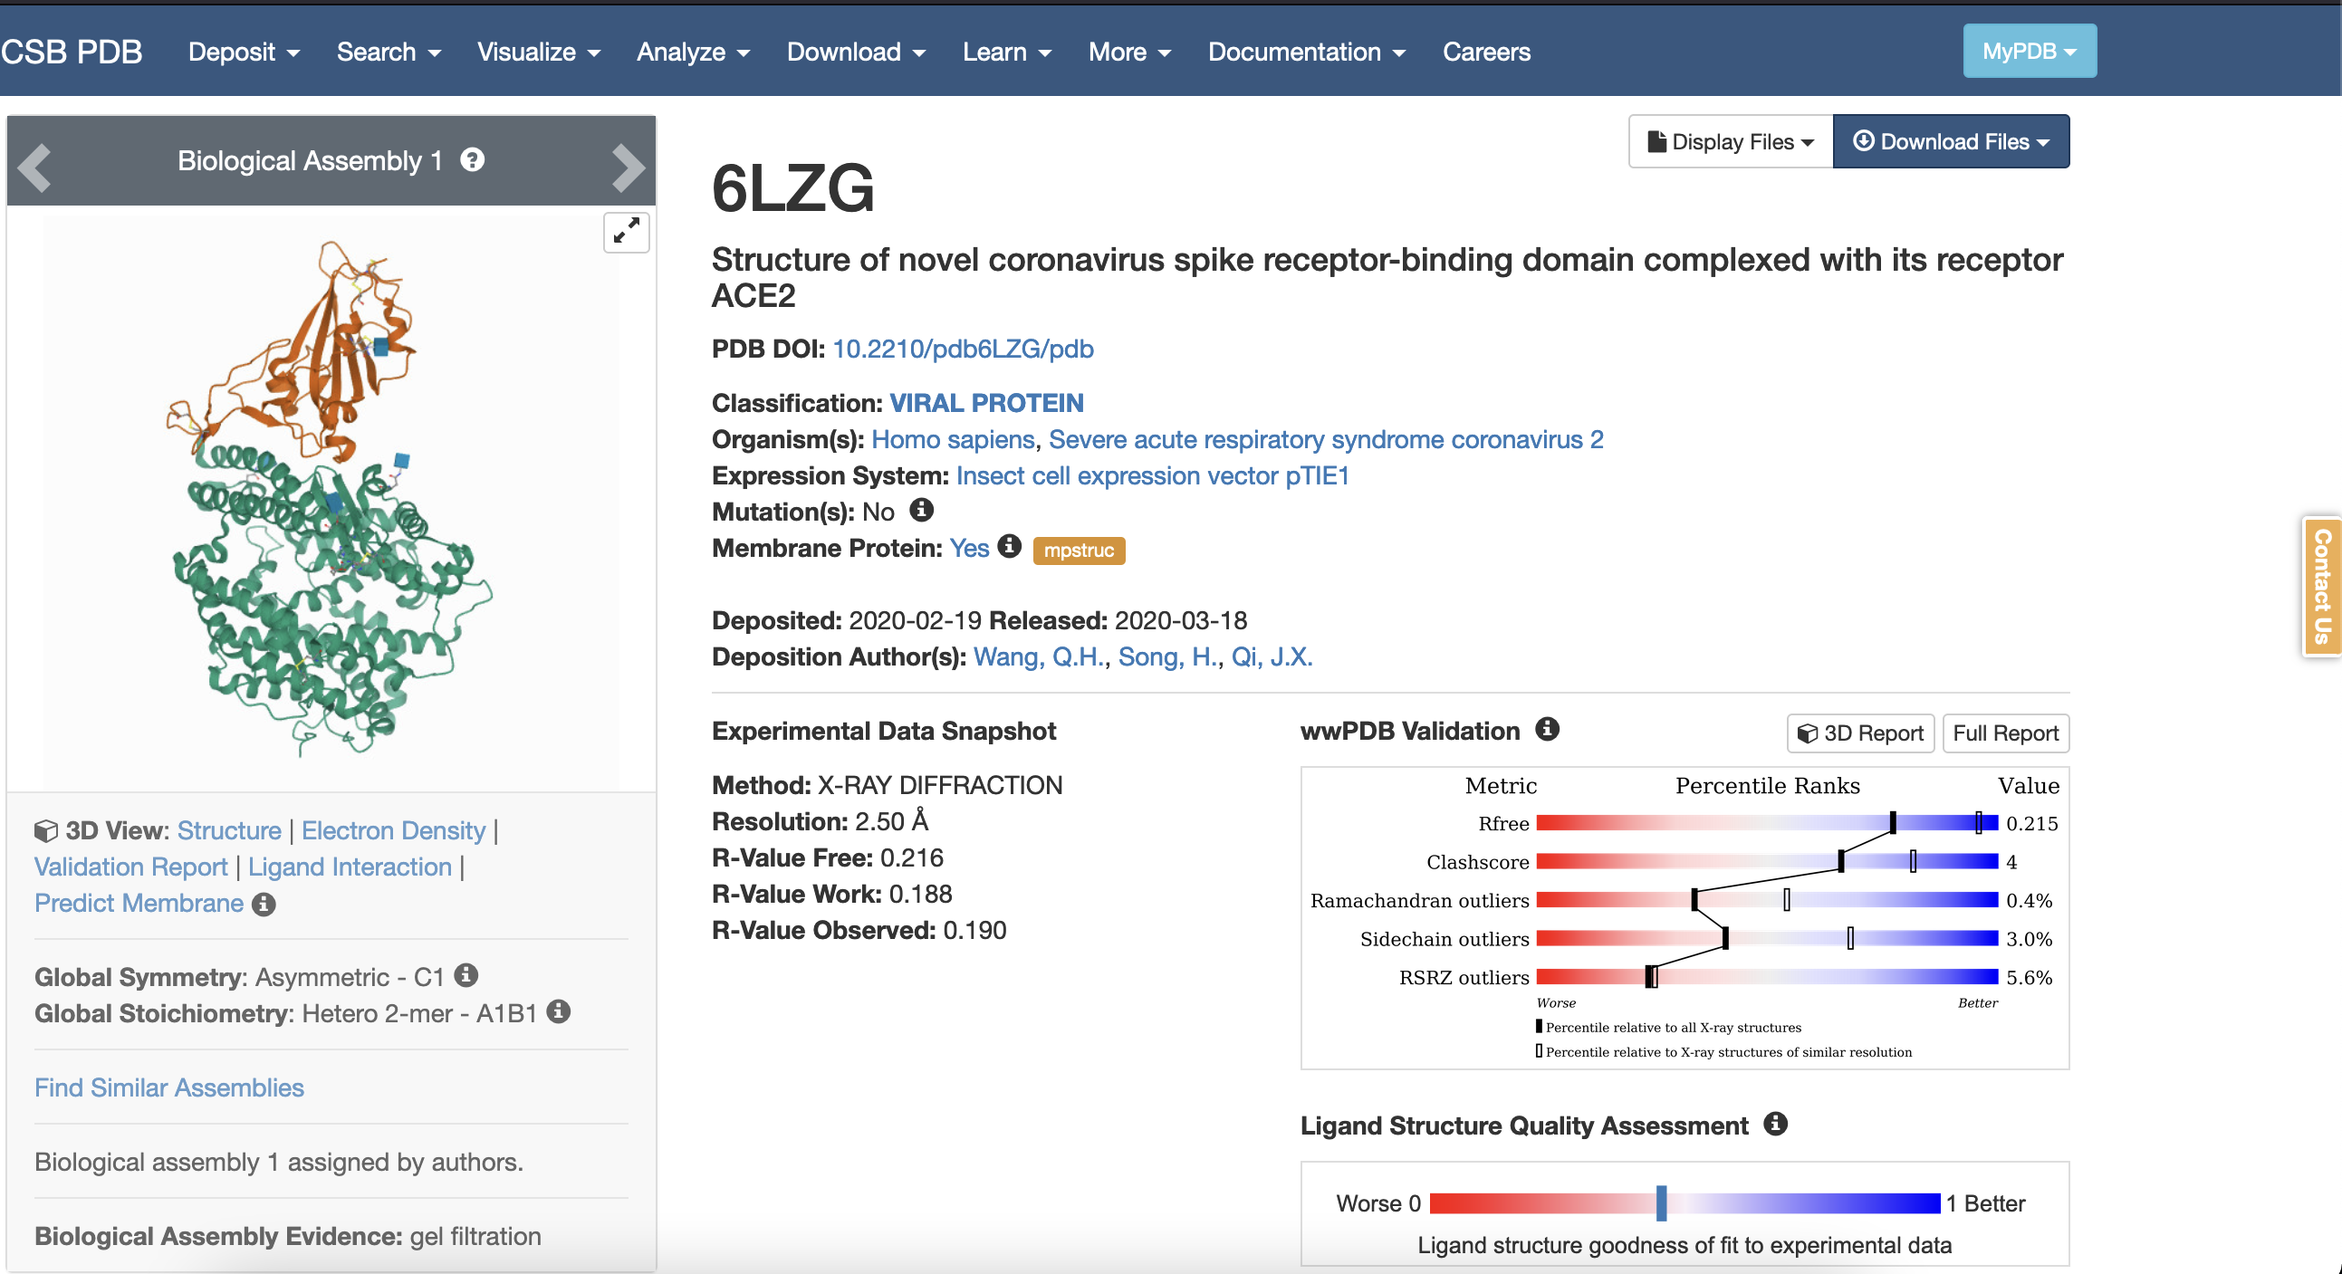
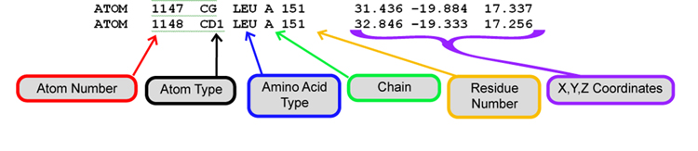
Protein Structure Files: PDB
3D Protein data is stored in a pdb file.
Pdb files for solved structures can be found at https://www.rcsb.org/
Proteins are accessed by four alpha-numeric ids optionally followed by a single letter chain id.
Ex 6LZG.B is the Sars-cov-2 spike protein.
Notes:
https://cbm.msoe.edu/markMyweb/jmolWebsite/2-3.html

Slide 5
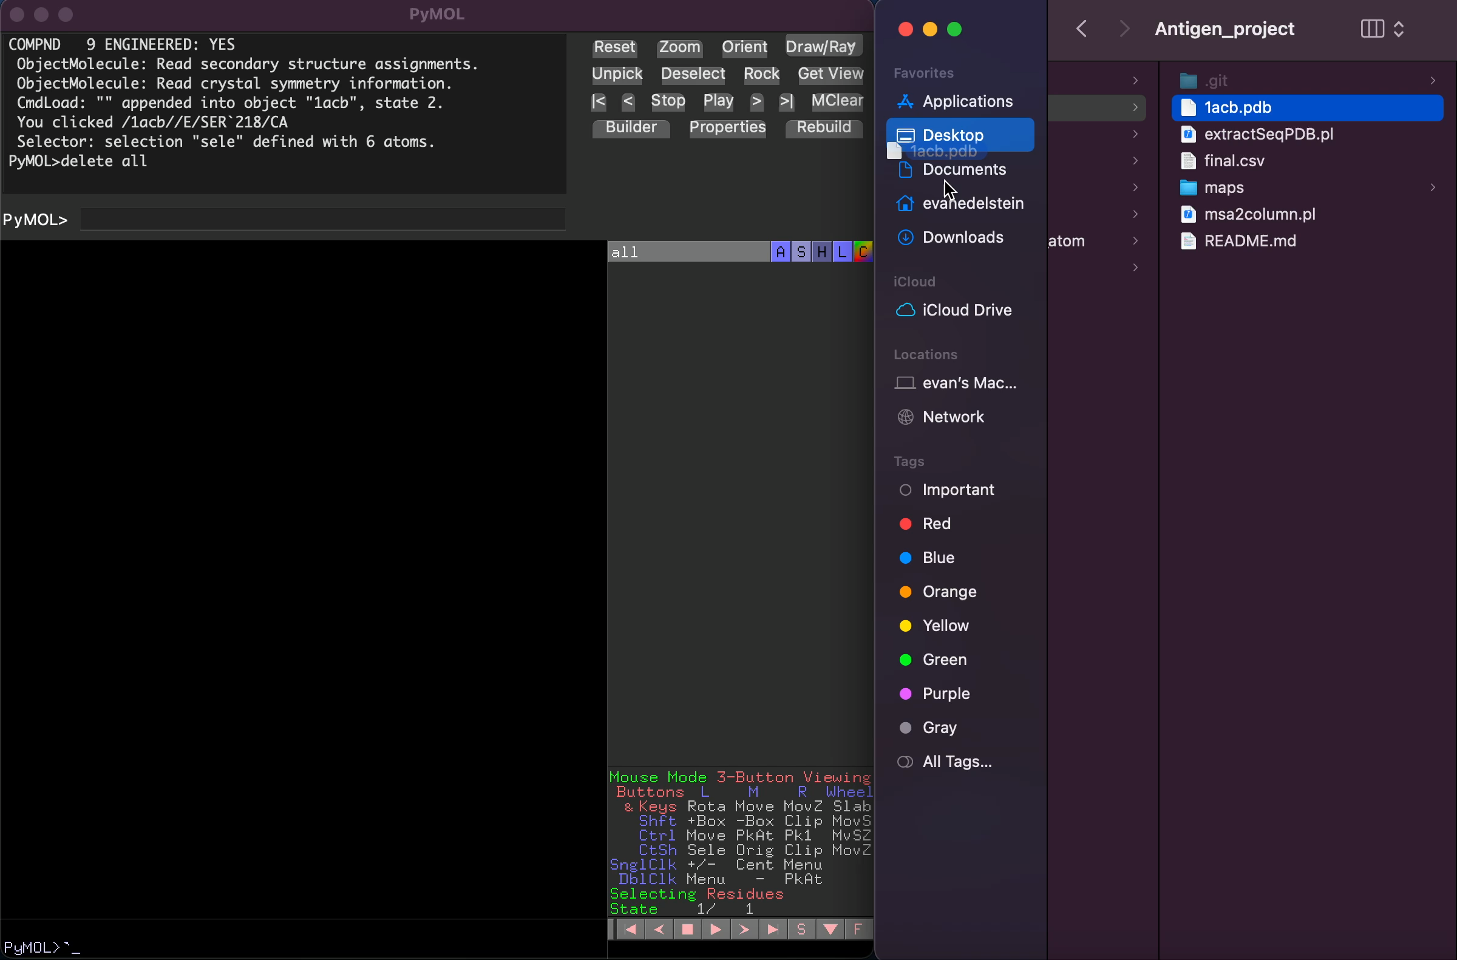
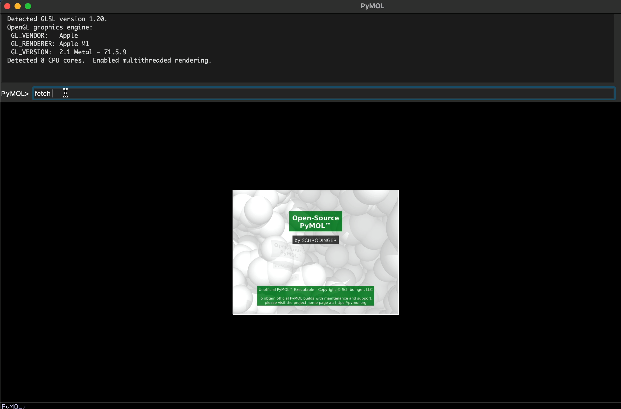
Displaying Structures:
Structures can be loaded in from pdb files by dragging and dropping.
Structures can can also be fetched directly from RCSB using PDB Id.
Structures can can also be loaded from directory.

Slide 6
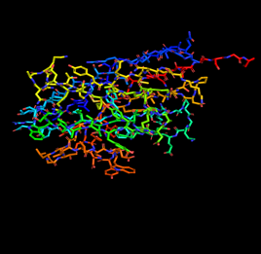
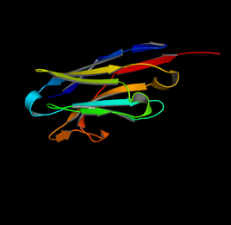
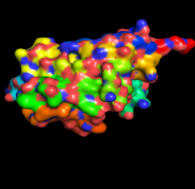
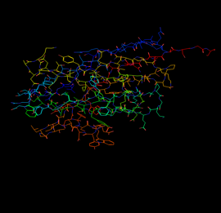
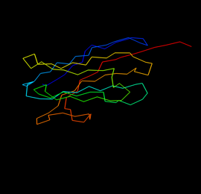
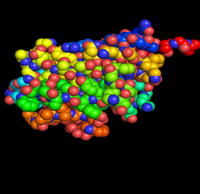
Representing Proteins
Sticks
Cartoon
Surface
Lines
Ribbon
Spheres

Slide 7
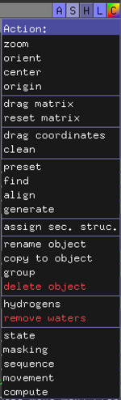
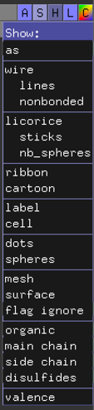
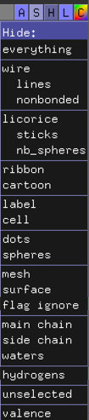
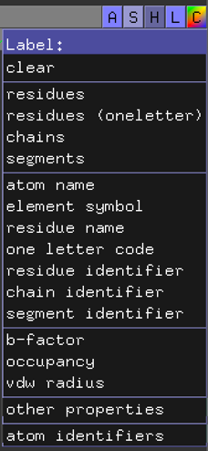
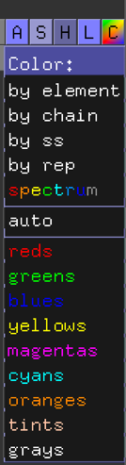
Manipulating Representation and Selections:

Slide 8
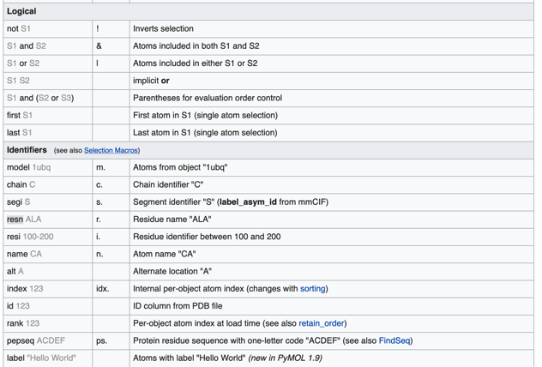
Selections and Objects:
Selections allow for manipulation of part of a protein:
select `name`, `selection algebra`
Selections will appear wrapped in parenthesis.
Selections can also be made by clicking on a structure.
Selections cannot override behavior of parent objects
Instead generate an object from a selection:
create `object name`, `selection name`

Slide 9
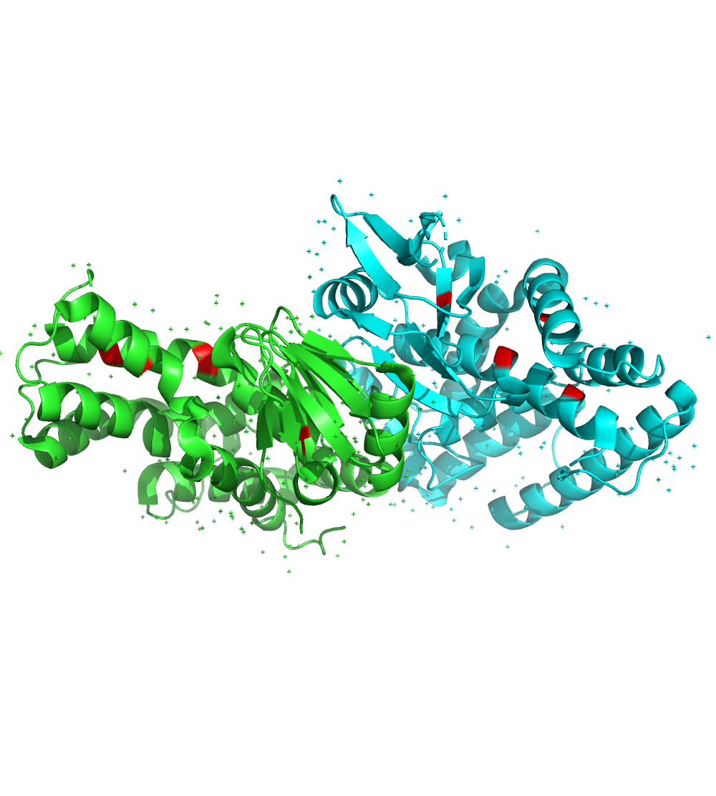
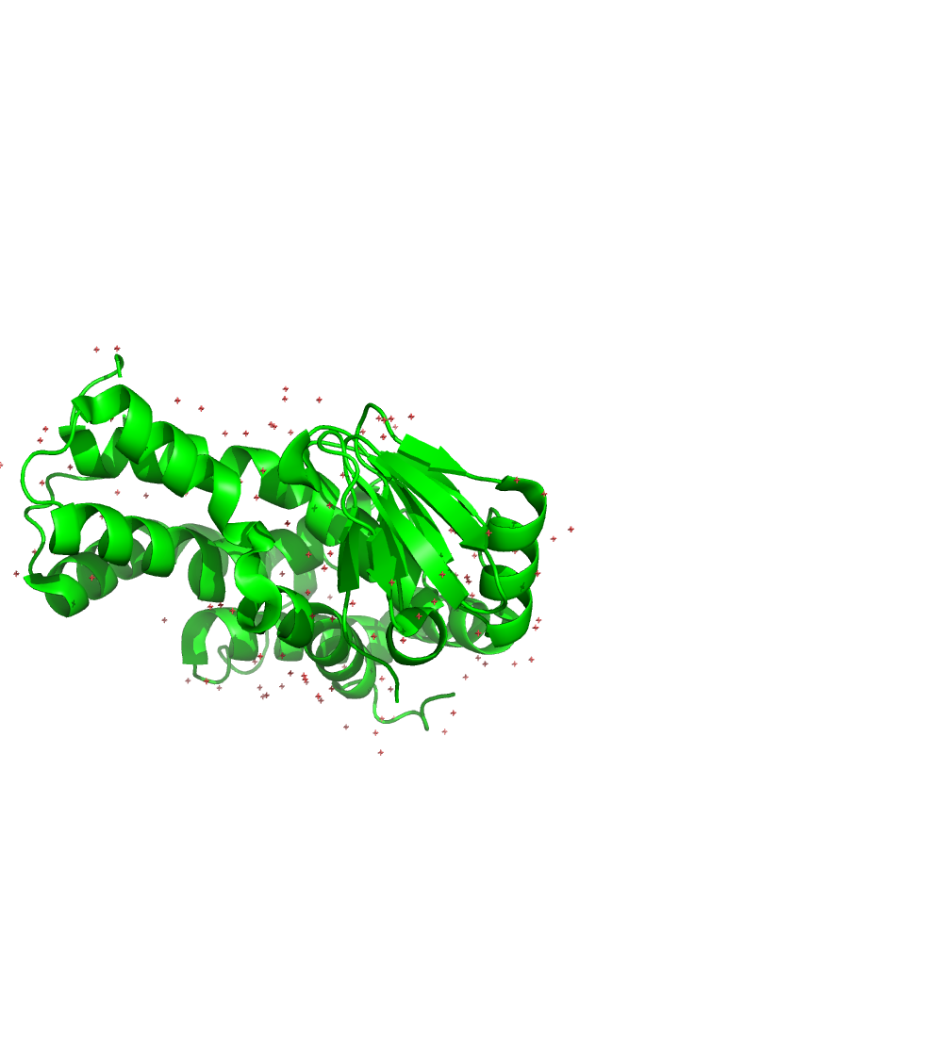
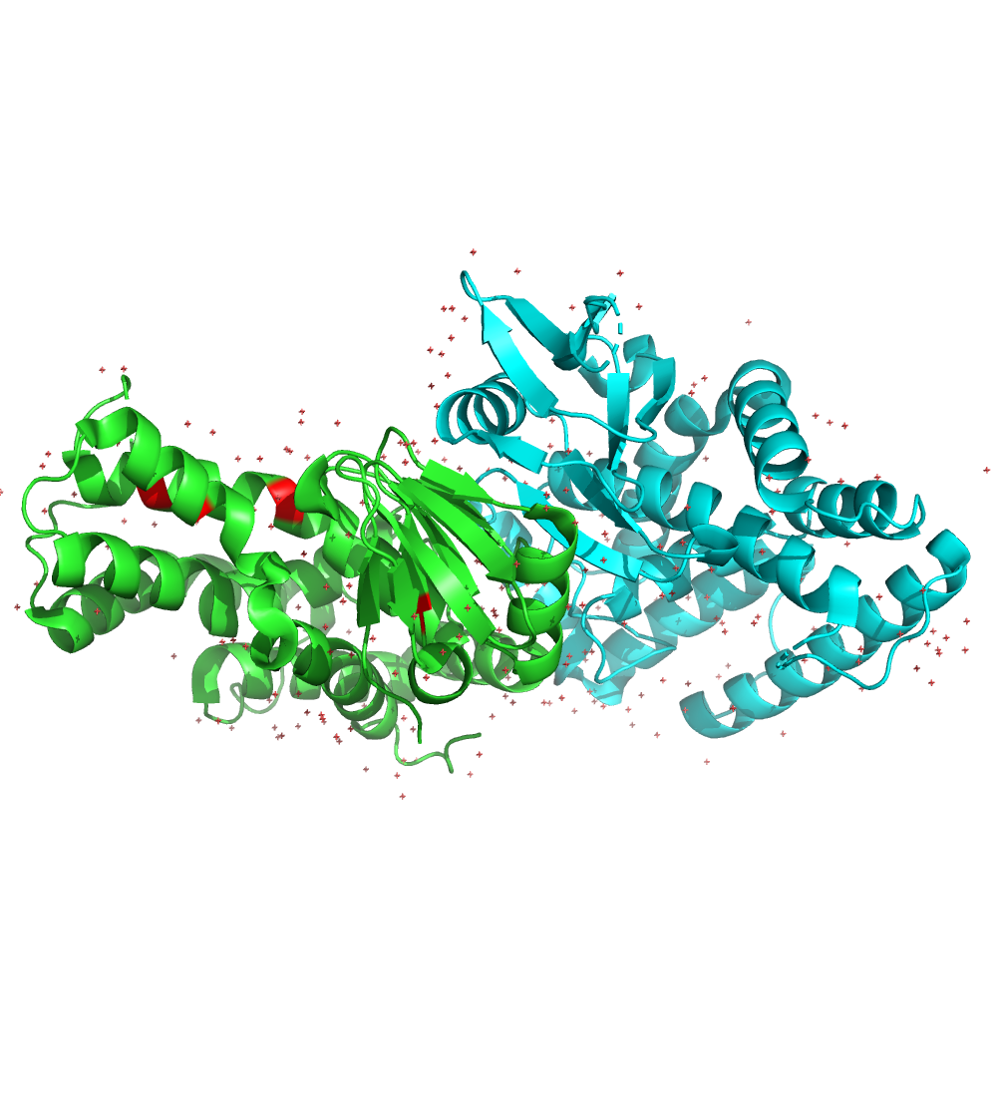
Selection Algebra:
Using pymols selection algebra allows for programmatic and fine-tuned manipulation of protein structures.
highlight all cystines red:
select cystines, resn CYS
color red, cystines
show only chain A and B:
Select A, chain A
hide everything, not A
Combine the two selections:
select cys_A, chain A and resn cys
color red, cys_A

Slide 10
Pymol Functions
Pymol has built in functions for many basic manipulations of selections or objects:
Load: load `filename`
Fetch: fetch `pdbid`
Color: color `color`, `selection`
Representations: show ` representation` , `selection`
Label: label `selection`, `label`
Distances: distance `selection1`, `selection2`
Align: align `selection1`, `selection2`
Save: png `filename`
Select: `name`, selection algebra
Create: `name`, selection algebra
Extract: `name`, selection algebra

Slide 11
The Essence of Pymol:
Ask a Specific Biological Question
Analyze the Selection to Formulate a Hypothesis
Translate the Question Into a Pymol Selection
Example
Question: Is there a stabilizing disulfide bridge at the interface?
Selection: ’select cystines, resn CYS’
Hypothesis: No, it doesn’t seem that CYS-CYS interactions are important at this interface.

Slide 12
Case Study: Sars-Cov-2 Mutations
Load 6LZG into Pymol.
Chains
Color the spike protein (chain B) and ACE receptor (chain A) different colors.
Label
Select, color and label the important spike protein positions.
Omicron
Repeat the above procedure for the Omicron variant (7WBL)
(residues 501,498,496,493)
Biological Question:
Do the spike protein mutations in the omicron variant lead toa change in interactions with Ace2?
Load
Selection

Slide 13
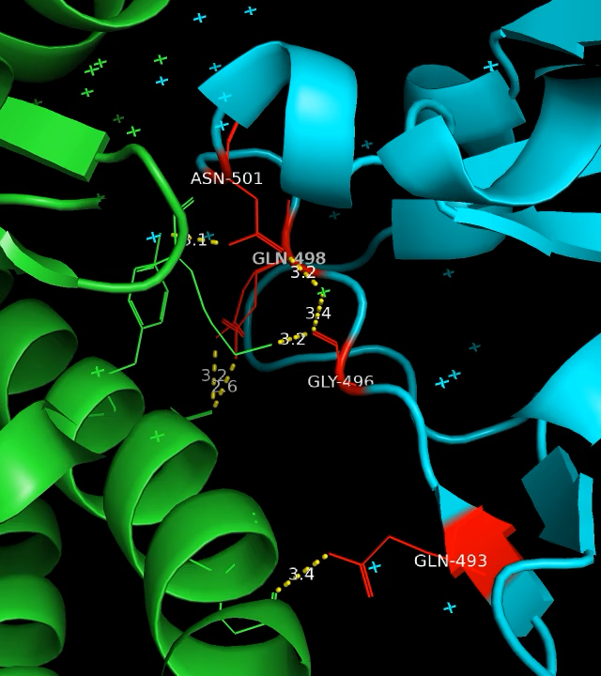
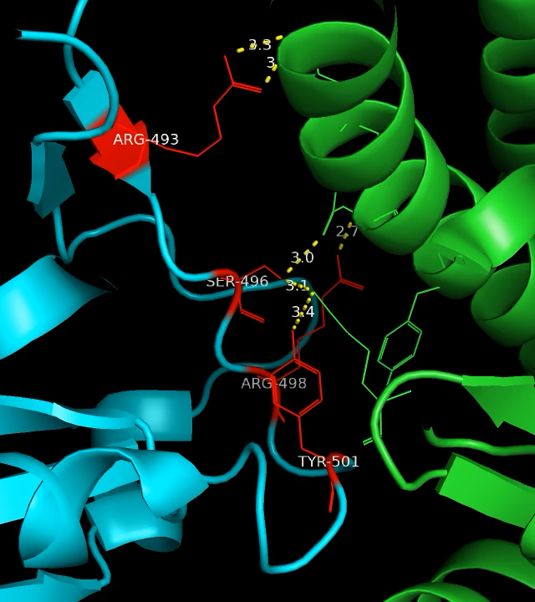
Case Study: Sars-Cov-2 Mutations
WT
Omicron
What Hypothesis can you draw from this?

Slide 14
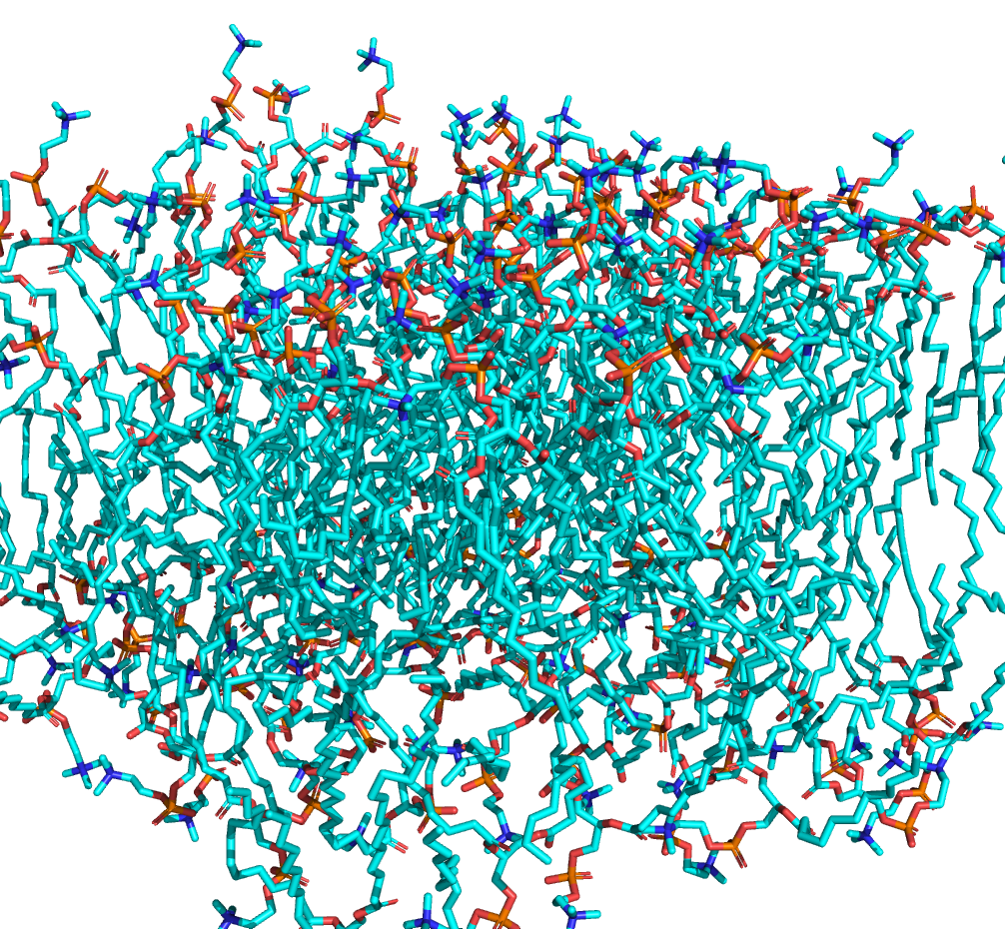
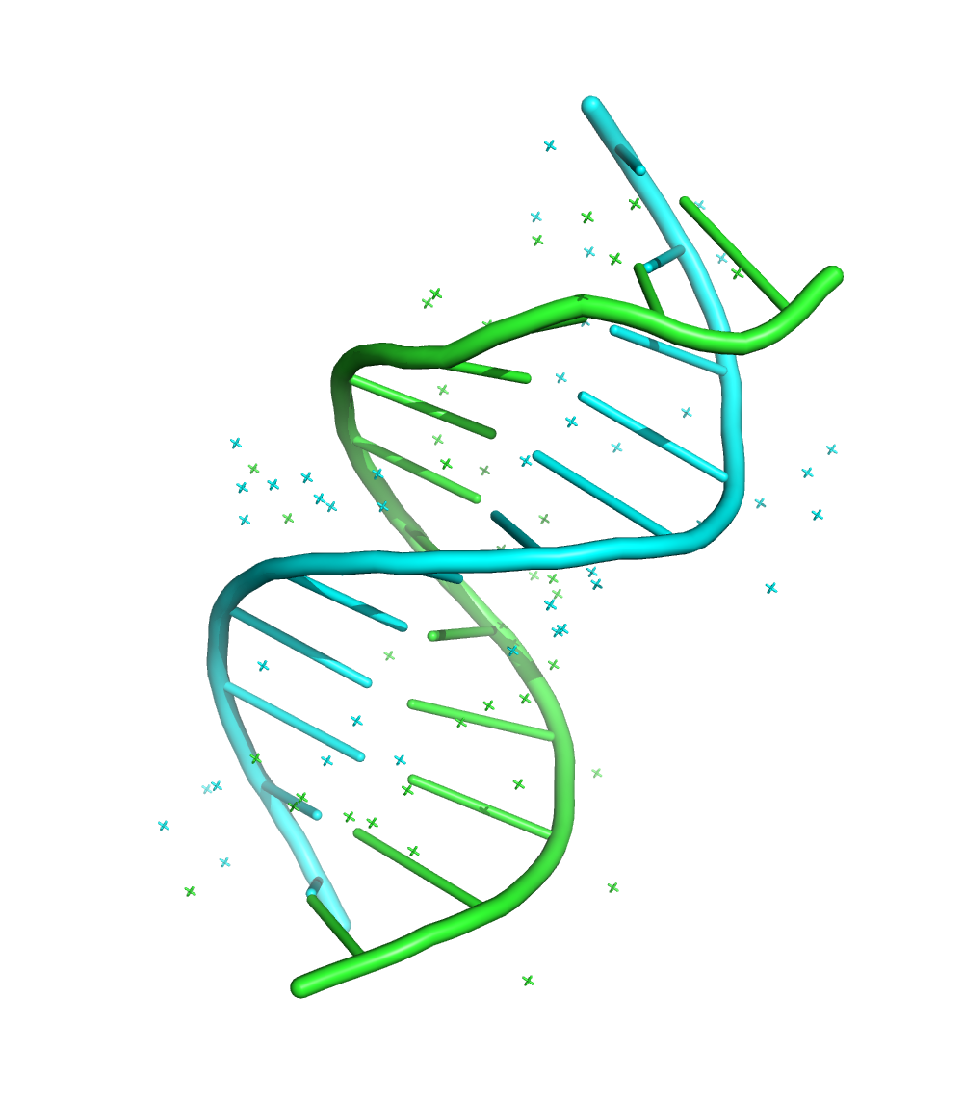
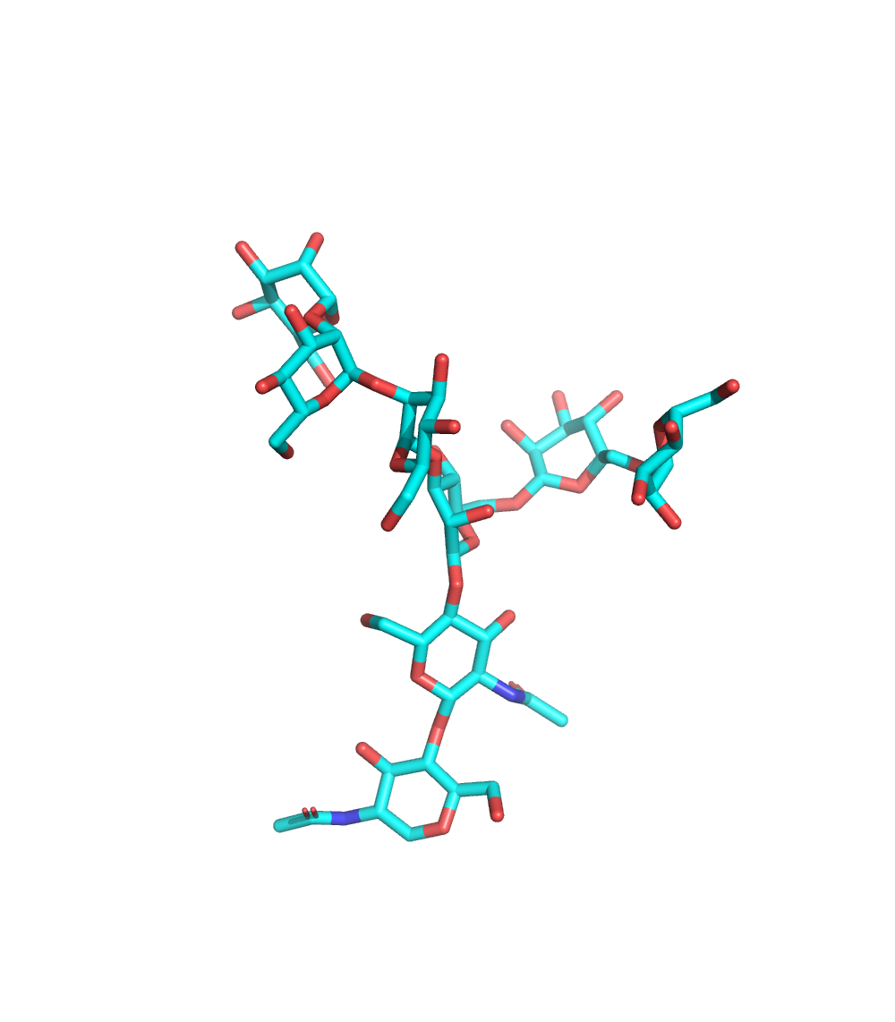
Extending Pymol Beyond Proteins:

